Slide 1
FYE Team Formation

Slide 2
Introduction to Application
The client sought a web application to automate team formation for ENGR 102, replacing the current manual process.
Team formation is based on student responses to questions regarding prior programming experience, gender, ethnicity etc.
The goal is to create balanced teams while avoiding conflicts or group combinations detrimental to underrepresented groups.
The current manual process is time-consuming and inefficient for large-scale implementation.
The desired solution is an app where students complete a questionnaire, the system assigns teams based on predefined criteria, and team assignments can be downloaded as a file.

Slide 3
Purpose and Stakeholders
Purpose: Automate and optimize student team formation.
Stakeholders:
Professors
Students

Slide 4
Features
Professor Dashboard – Before we get student responses
Professor login
Create and customize forms to collect student data.
Define attributes, set weightages, and manage submission deadlines.
View, update and destroy configurations as needed.
Upload students’ information.
Publish form
Logout

Slide 5
Features
Professor Dashboard – After getting student responses
View all student responses
View individual student responses
Generate teams
View teams
Export to different file types

Slide 6
Features
Student Dashboard:
Student login
View/Respond to Available forms
Fill responses to a form
Save the responses as a draft
Submit responses
Logout

Slide 7
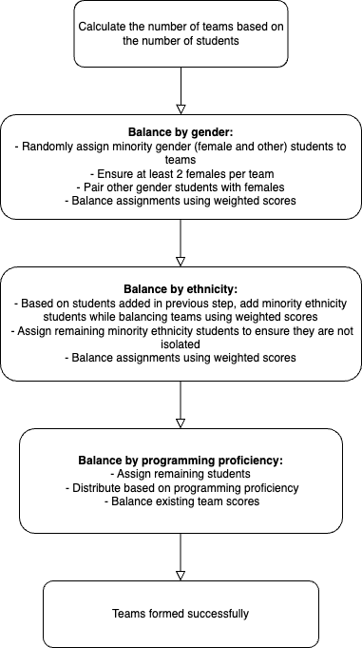
Design choice for back-end logic

Slide 8
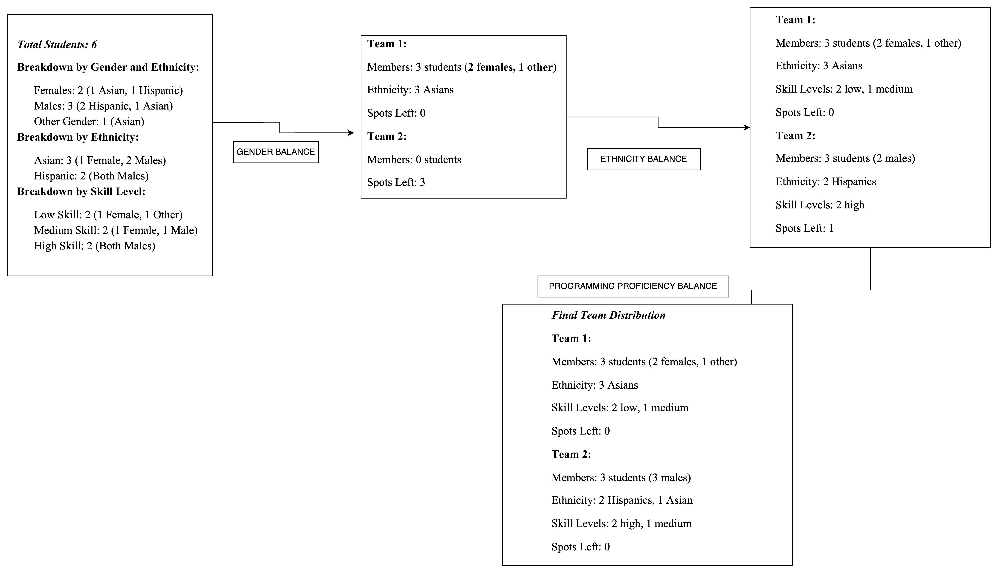
Example

Slide 9
Challenges
Handling Courses and Sections
Initial Uncertainty: Unclear whether to support multiple courses/sections separately. Explored various scenarios to address this need.
Final Approach: Opted to incorporate sections directly within the existing database table. Simplified implementation while maintaining functionality.

Slide 10
Challenges
Core Logic for Team Formation
Initial Plan: Implemented a complex logic with swaps after assigning teams based on gender and ethnicity. This approach proved to be overly complicated and difficult to manage.
Final Approach: Developed a simpler and more efficient logic. Introduced a more organized data structure to store and manage team distribution effectively.

Slide 11
Lessons learnt
Recognizing and respecting the diverse working styles and methodological approaches of team members is crucial for collaborative project success.
Throughout the project, we discovered the importance of being flexible. Our initial concept transformed as we progressed, and this adaptability ultimately led to a more effective solution.
Given our constraints, we realized it was more effective to perfect the core features first. This approach helped us deliver a functional solution without getting overwhelmed by unnecessary additions.
Within the team, effective communication is crucial.

